Slide 1
EDA Project
T5004
Abdulaziz Alshehri

Slide 2
AGENDA
Analysis Questions
Data
Cleaning
Preparation
Results
Conclusion
Recommendations

Slide 3
Exploratory Data Analysis (EDA) Project
What patterns people follows in the NYC subway?
Relationship between the NYC subway and taxies?

Slide 4
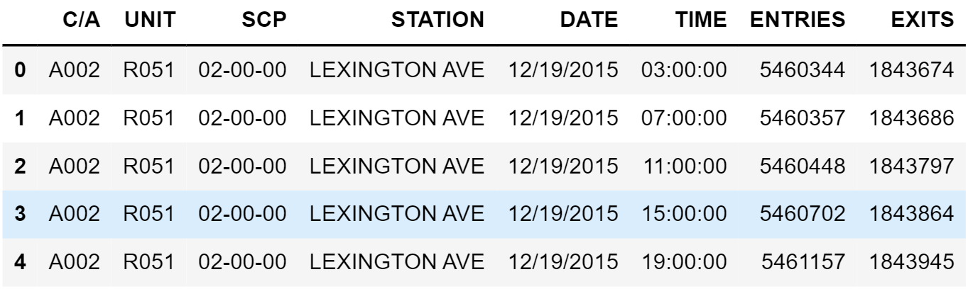
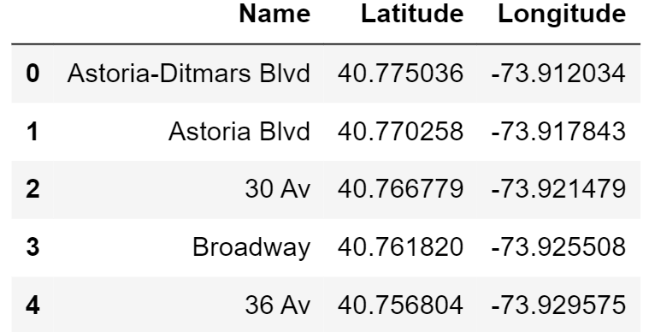
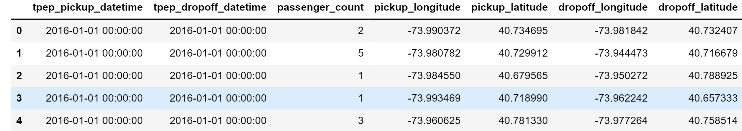


DATASETS
MTA
Station Name (common column)
STATIONS
TAXIES

Slide 5
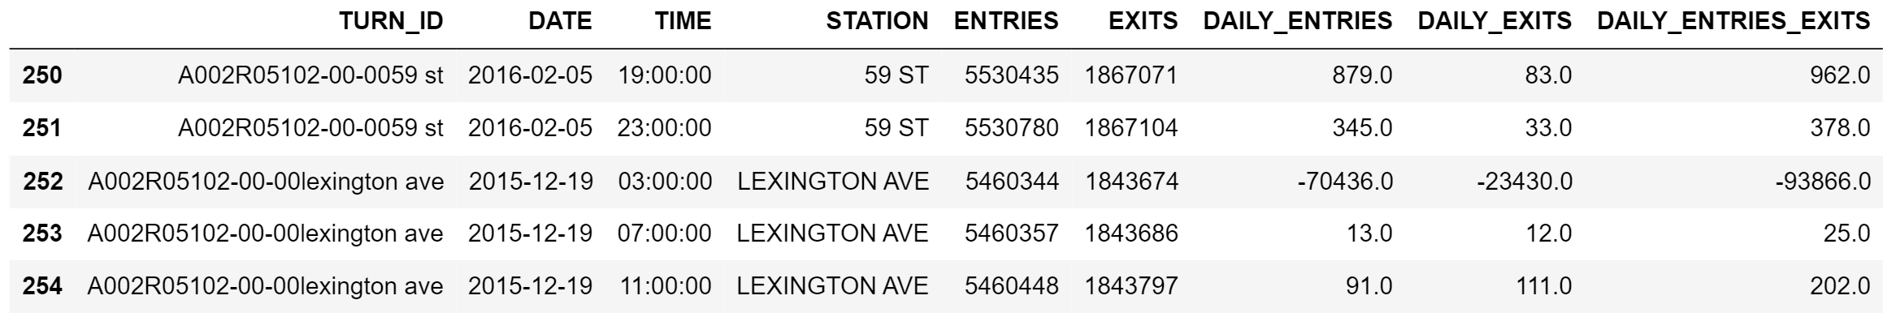
CLEANING MTA – Wrong Data
Wrong Subtraction between two different turnstiles

Slide 6
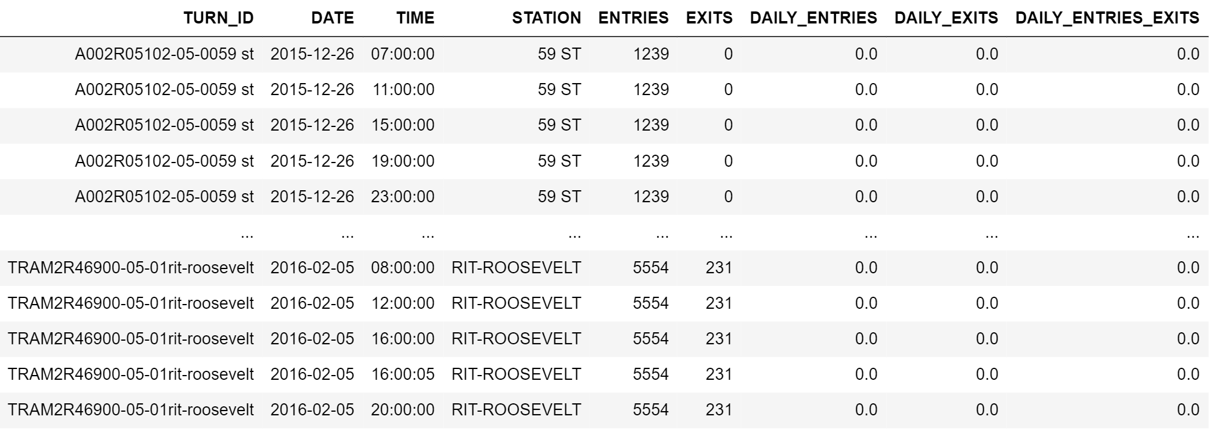
CLEANING MTA – Off-Duty Turnstiles
Turnstiles values not changing

Slide 7
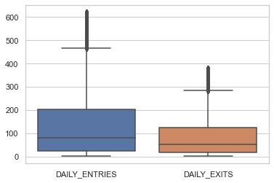
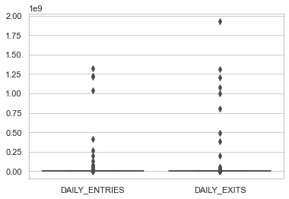


CLEANING MTA - Outliers
Before removing outliers
After removing outliers

Slide 8
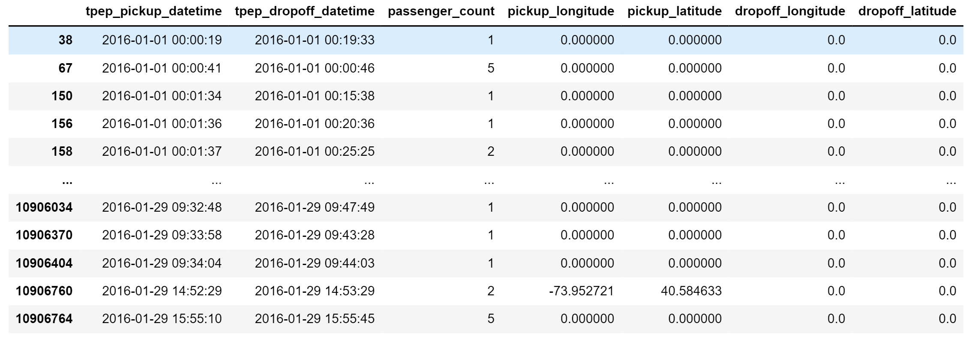
CLEANING TAXI – Zeros and Duplicates
zeros coordinates
duplicate rows

Slide 9
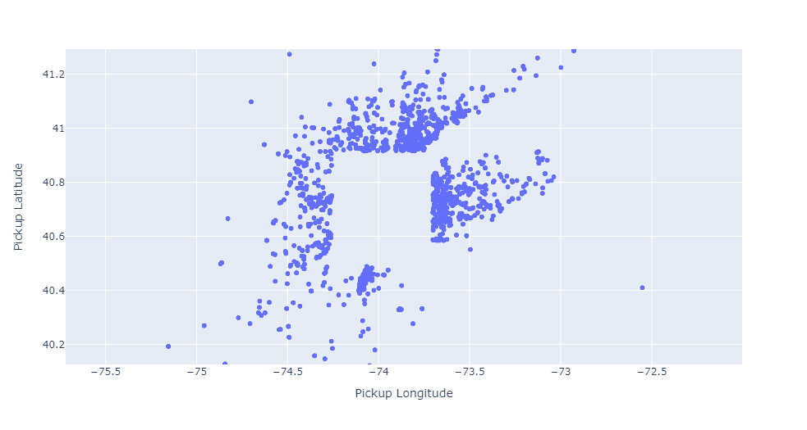
CLEANING TAXI – Locations Outside NYC
NYC

Slide 10
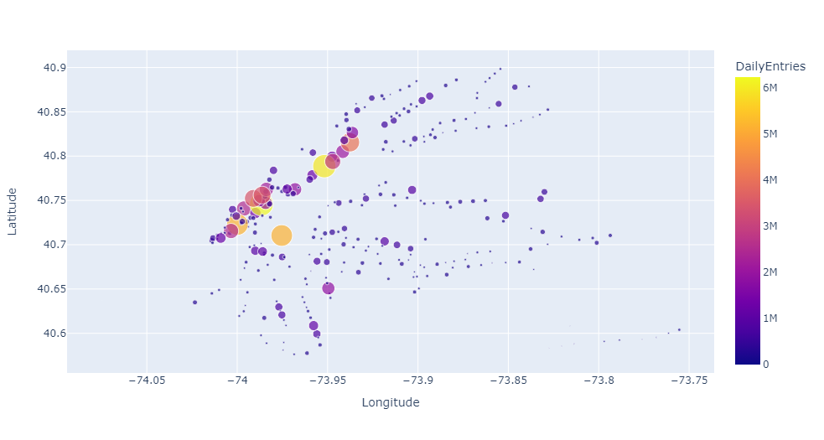
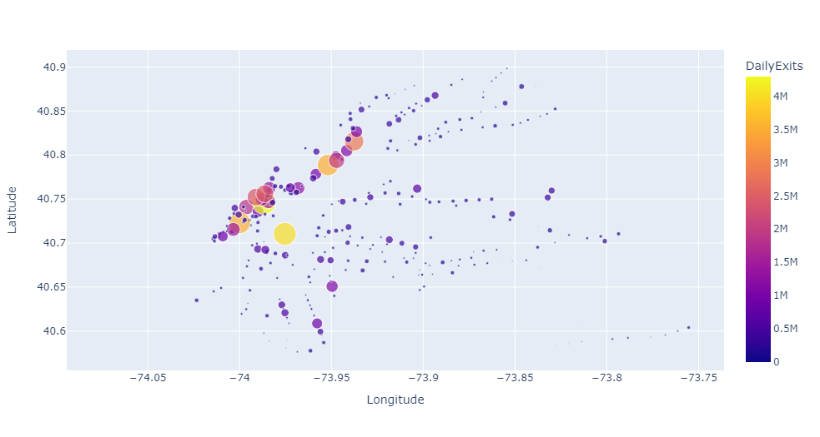
RESULTS – Entries vs Exits
Exits
Entries

Slide 11
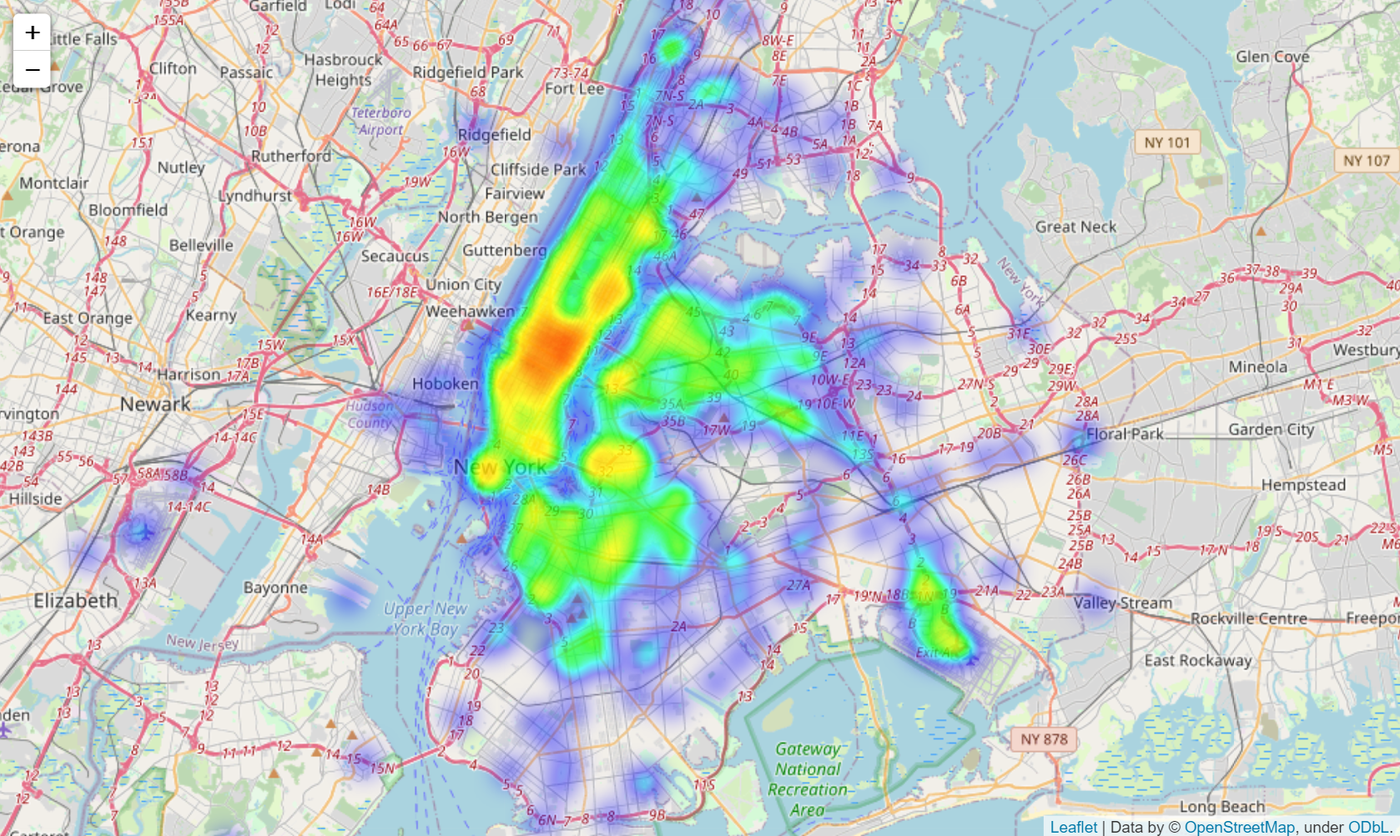
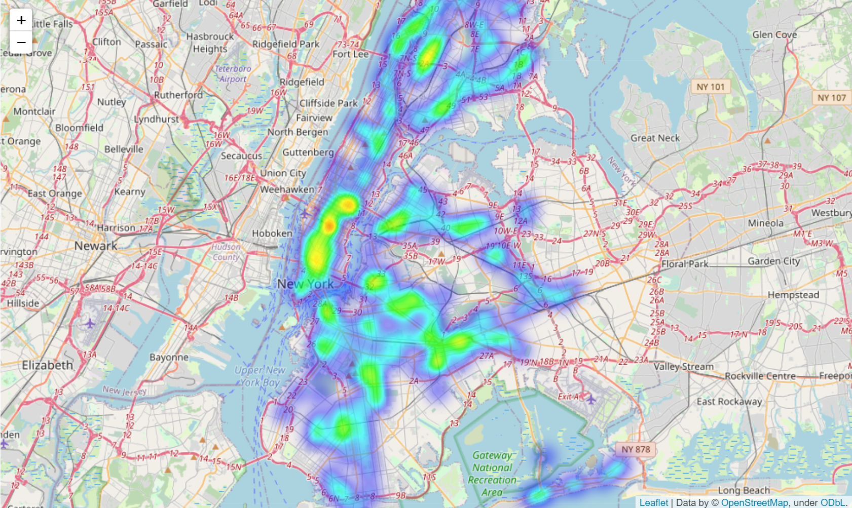
RESULTS – Subway Exits vs Taxi Pickups
subway exits heatmap
taxi pickups heatmap

Slide 12
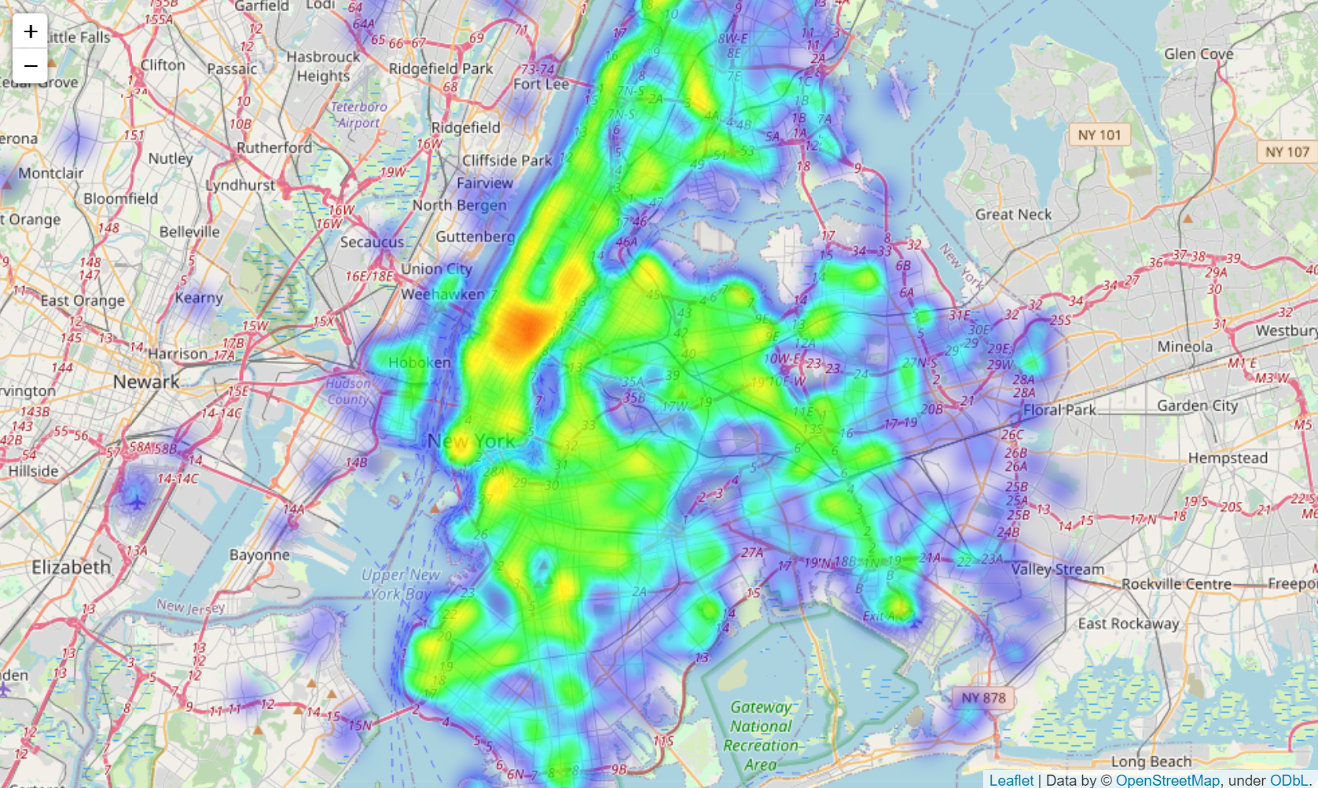
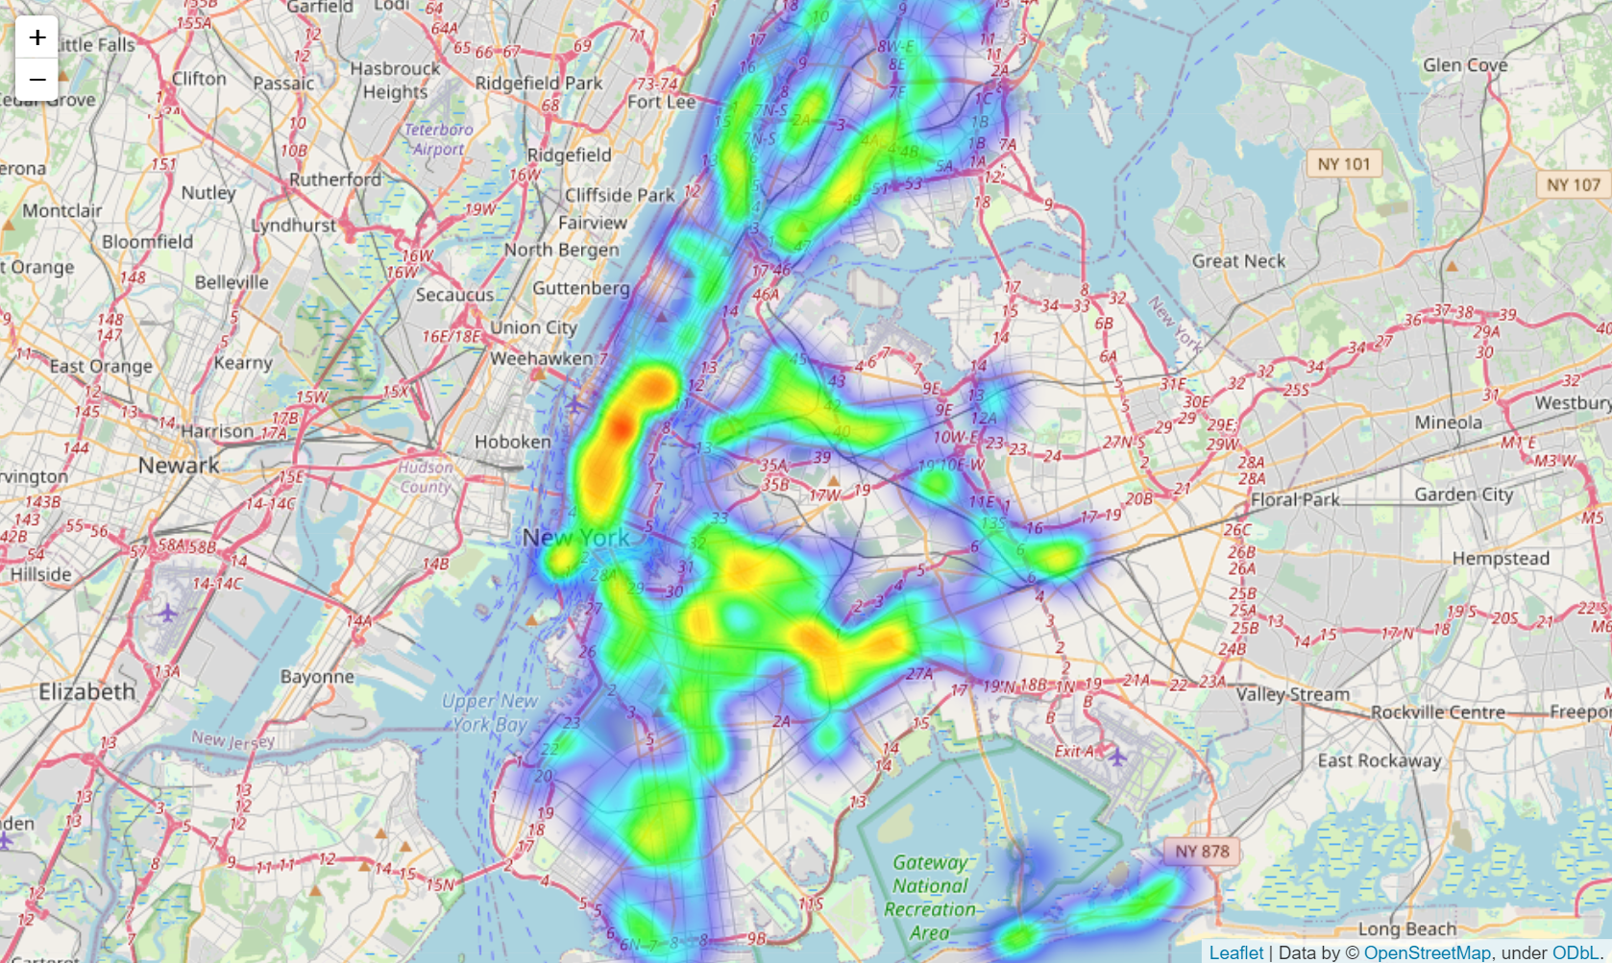
RESULTS – Subway Entries vs Taxi Dropoff
subway entries heatmap
taxi dropoff heatmap

Slide 13
CONCLUSIONS
MTA and STATIONS datasets joined to get stations locations.
SATAIONS dataset didn’t require any cleaning.
Plotting entries vs exits show that Manhattan is the busiest.
Plotting entries/exits vs drop-off/pickups show possible spots for further study.

Slide 14
RECOMENDATIONS
Based on our analysis, our recommendation for TLC is to direct their taxi drivers to the areas that have subway exits more than taxi pickups.

Slide 15
FURTHER WORK
This analysis can be enhanced in many ways:
Including weather data.
Extending the analysis to involve weekends vs weekdays.
Considering whole year.

Slide 16
Questions..

